Slide 1
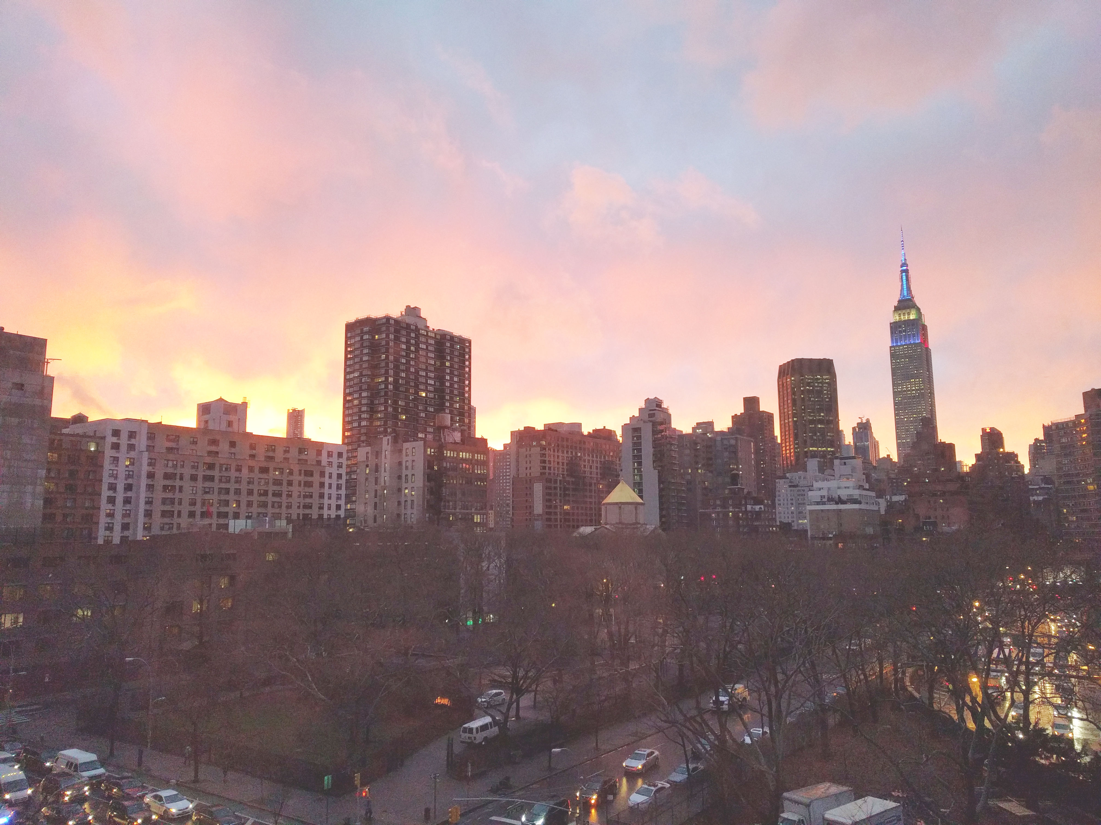

Slide 2
Introductions
Co-Organizers
Interested in becoming a co-organizer? Let me know!
Brian Jablonsky

Slide 3
News
Follow us on Twitter: @NYCDotNetDevs
Code Assessment with .NET Upgrade Assistant - https://bit.ly/4bHPEN7
3rd party API and package map support for .NET Ugrade Assistant - https://bit.ly/3Y0QGke
Visual Studio updated through Microsoft Update - https://bit.ly/4bHwmYj
OpenAI Library for .NET - https://bit.ly/3VYGdDc
.NET 9 Preview 6 - https://bit.ly/4f1W9gs

Slide 4
Other NYC Meetings
TBA – NYC PowerShell Meetup TBA (https://www.meetup.com/NycPowershellMeetup/)
Thursday, July 18th – NYC AI/LLM/ChatGPT Developers Meetup “GenAI, LLMs and ML” (https://www.meetup.com/nyc-llm-talks/)

Slide 5
.NET Virtual User Group
https://dotnetfoundation.org/community/virtual-user-group
Attend another .NET User Group virtually!
Constantly adding new user group meetings
Replay some of the meetings you might have missed

Slide 6
.NET Aspire Developer Day
https://aka.ms/dotnetAspireDevDay
July 23, 2024 – 11:00AM – 8:00PM ET
Online – livestream
Free
Dive deeper beyond the basics of .NET Aspire and Cloud native development.

Slide 7
Upcoming Meetings
Thursday, August 29th – TBA
Thursday, September 26th – TBA
Thursday, October 17th – TBA
Thursday, November 14th – “.NET Conf 2024/.NET 9 Release”
Thursday, December 12th – TBA

Slide 8
Announcements
Call for presentations!
Have an idea/topic for a presentation?
Want to give a presentation?
Brian (brian@nycdotnetdevs.com), or tweet @NYCDotNetDevs

Slide 9
Announcements
State of User Group Survey
We’ll be sending out a survey via Meetup to gauge your interest in what you want to see from the user group
Submit your survey anonymously, or add an email address and be entered to win some prizes

Slide 10

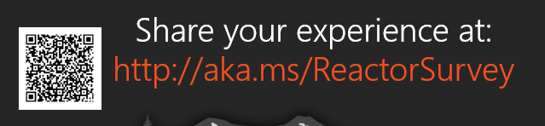
Sponsors
Microsoft Reactor http://microsoftreactor.com
Microsoft Reactors are developer community hubs providing technical events, community networking, and collaboration. They are graciously sponsoring our group in 2019 by providing our meeting space and food! Please fill out the survey at the end of the meeting!

Slide 11

Reactor NYC
@MSFTReactor
#ReactorNYC
How was your Meeting?

Slide 12

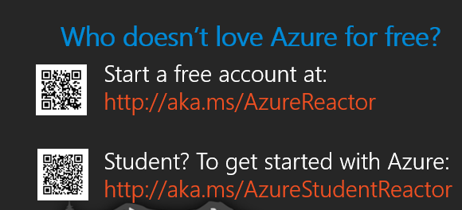

Reactor NYC
@MSFTReactor
#ReactorNYC

